Slide 1
Performance Audits
A Tool to Objectively Evaluate Efficiency, Economy, and Effectiveness of Operations and Programs
Notes:
WE PROVIDE independent, objective, and meaningful answers to questions about government performance. Our aim is to hold agencies accountable for their policy implementation, program management, and expenditure of public funds. What is obvious in your world that to the rest of us may be extremely unobvious? We are going to talk today about how we shine a light on operations and bring fresh perspective and insights to improve them for employees, clients, and the public.

Slide 2
The Ohio Auditor of State
The Office
As one of five independently elected statewide offices under Ohio’s Constitution, the Auditor of State’s office strives for clean, accountable and efficient governments for the people of Ohio.
With a statewide staff of more than 800 auditors and other professionals, the Auditor of State’s office has a wide range of responsibilities.
Notes:
AOS has a central office in Columbus and 7 regional offices around the state in Akron, Athens, Cincinnati, Cleveland, Dayton, Toledo, and Youngstown.

Slide 3
The Ohio Auditor of State Responsibilities
Audit all public offices in Ohio (more than 5,900 entities) including cities, counties, villages, townships, schools, state universities and public libraries, as well as all state agencies, boards and commissions.
Conduct performance audits of state and local public offices,
Identify and investigate fraud in public agencies,
Provide financial services to local governments,
Promote transparency in government.
Notes:
Although many think of us for financial audits, we have a range of other responsibilities and offer other services to support governments at all levels in Ohio. Some accomplishments since Audtor Faber took office in 2019:
More than 90 criminal convictions
Discovered more than $5B in COVID related unemployment compensation fraud
141 findings for recovery totaling nearly $16M
Reduced budget within AOS office by $400,000

Slide 4
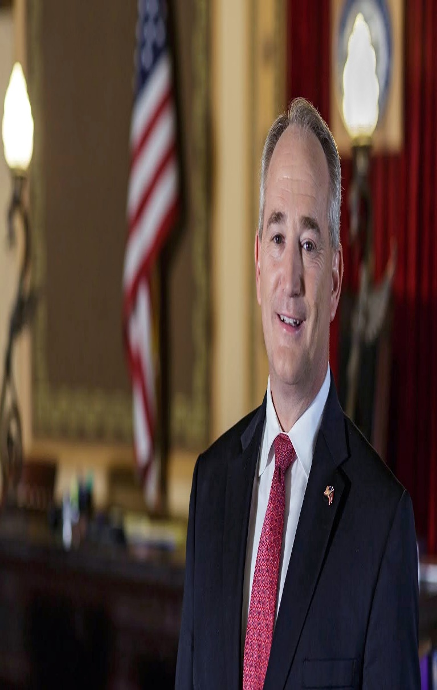
Auditor Faber
Ohio’s 33rd Auditor of State, Keith Faber
Dedicated to ensuring efficient, effective and transparent government for the people of Ohio.
From 2001-18, Faber served Ohioans in the state legislature, including time as President of the Ohio Senate.
Notable legislative accomplishments that have translated to his role as Auditor of State include:
  Created the Ohio Senate President’s 5 Percent Challenge which resulted in statewide average savings of 12 percent for higher education students.
  Streamlined the public-records mediation process, making public records more accessible and affordable to the public
  Introducing legislation to increase the number of performance audits and allow the legislature to use performance audits to review state agencies.
Notes:
To make sure every Ohioan has the opportunity to succeed, Auditor Faber recognizes the importance of job creation and economic development. He has strived to make Ohio a more business friendly state by removing burdensome regulations, cutting personal income taxes and small business taxes. Auditor Faber also led the call on the United States Congress to pass a balanced budget amendment.

Slide 5
“One of the great mistakes is to judge policies and programs by their intentions rather than their results.”
-Milton Friedman
Notes:
We want to judge programs by what they do not by what they say they will do.

Slide 6
Differences between Financial and Performance Audits
Performance Audits
Have a proactive, forward focus.
Identify areas of inefficiency or ineffectiveness.
Provide recommendations for improvement of performance.
Financial Audits
Determine if the entity has followed laws, rules, and ordinances.
Verify public funds are spent appropriately and lawfully.
Review methods, accuracy and legality of accounts and financial reports.
Notes:
While financial audits determine if public funds are spent legally and managed in accordance with accounting principles, performance audits examine if funds are spent wisely and if programs achieve their intended purpose.
A performance audit is an evaluation of how well a government function, agency, program, or activity is working. The purpose of these audits is to provide legislators and agency management with accurate, unbiased information which can be used to create, manage, oversee, and modify agencies or programs.
Performance audits have a different scope and are typically longer duration than financial audits.

Slide 7

What is a Performance Audit?
Performance audits provide elected officials and government employees with an objective, third-party analysis of their operations to help them:
Improve Performance
Reduce Costs
Make Informed, Data-Driven Decisions
Notes:
Performance audits are beneficial to all types and sizes of government, from townships and villages to large state agencies. A performance audit can be designed to increase customer satisfaction, reduce costs, align operations with mission and strategy, or improve the efficiency and effectiveness of operations. The Ohio Performance Team operates like a consulting group with a proactive, forward focus. The Ohio Performance Team has worked with a broad range of local and state entities to improve performance and outcomes.

Slide 8
Performance Audit Principles:
The principles guiding performance auditing are often called the “Three E’s”:
ECONOMY
Keeping the
costs low
EFFICIENCY
Getting the most out of available resources
EFFECTIVENESS
Achieving the objectives or goals of the program
Notes:
Economy – Acquisition of resources in the right quantity of the right quality at the right time and place at the lowest possible price. Includes people, financial, physical, and information.
Efficiency – Optimal relationship between output of goods, services, or other results and the resources used to produce them.
Effectiveness – The extent to which set policy objectives, operational goals, or other intended effects are achieved.
Questions performance audits can answer:
Is this program accomplishing its goals and objectives? Are there other ways to achieve this goal? Is this goal still relevant? How do other states achieve this goal or fulfill this need?
How well does the program do what it is intended to do? How many are served? What does it cost per unit? How does Ohio compare to other states in this regard? How do we compare to peers?
Is this program complying with all applicable laws and regulations? Does the program meet all federal grant requirements? Is the program fulfilling any obligations mandated by state law?
Some possible outcomes from a performance audit could include: Increased customer satisfaction, reduced costs, better aligned operations, improved efficiency and effectiveness of operations.

Slide 9

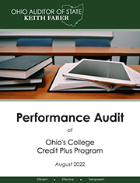
A Sample of Recent Audits
2023
ODAS Multi-Agency Radio Communication System (MARCS)
Ross Local School District
Medina County Board of Developmental Disabilities
ODNR Dredge Program
ODJFS Office of Workforce Development
2022
City of Hilliard
Franklin City School District
Stow-Munroe Falls City School District
Ohio’s Co-Located Institutions of Higher Education
Ohio’s College Credit Plus
ODNR Orphan Well Program
Minford Local School District
Madison Local School District
Waterloo Local School District
Wauseon Exempted Village School District
Blanchester Local School District
ODHE Facilities Inventory
Springfield Local School District
Northwestern Local School District
2021
ODPS Audit Report
City of Lorain Audit Report
Crawford County Landfill Audit Report
The Ohio Department of Health – COVID-19 Data
Ohio Department of Education
Ohio Department of Transportation
Notes:
Generally, performance audit offers benefits such as identifying:
• waste and inefficiency in delivering public services;
• opportunities to maximize return on investment in public services;
• risks to the achievement of policy goals; and
• matters of social and economic concern to citizens.

Slide 10
The Impact of Our Work (1995-2022)
Completed over 400 performance audits with recommendations for savings in excess of $187.3 million.
For every dollar invested in a performance audit, we identified taxpayer savings of approximately:
  $27 in higher education,
  $27 for state agencies,
  $7 in local governments,
  $35 in school districts.
Notes:
Our audit work is conducted in accordance with government auditing standards issued by the U.S. Comptroller General. Those standards require that we plan and perform the audit to obtain sufficient, appropriate evidence to provide a reasonable basis for our findings and conclusions based on our audit objectives.
Some of our key standards and practices are:
Integrity - Providing independent assurance on success claimed by government
Accountability - Helping to hold the executive to account for its performance
Transparency - By publishing new information, we can shine a light on how public resources are used
New insights - Applying analytical techniques that have not yet been used by government; Sharing best practices from Ohio and nationwide; Offering insight based on experience of auditing similar activities in other departments.
Making practical recommendations - Including recommendations in performance audit reports that enable the audited entity to improve its performance
Clarifying complexity - Providing an easy-to-digest summary of complex topics

Slide 11
Key Points about Performance Audits:
Performance audits are collaborative.
  They require the participation of the organization being audited.
Common performance audit areas include program results/operations, staffing, compensation, contract management, and facility, fleet, and asset use.
Performance audits adhere to government auditing standards.
Cost for an audit varies based on depth and breadth of work performed.
  The Auditor of State’s office works for taxpayers and keeps audit costs low.
Notes:
In practice, most performance audits answer a combination of these types of questions. OPT performs audits that evaluate the efficiency of operations and the effectiveness of programs, and can range from an audit of a specific case or individual to an audit of an entire agency.
Performance audits can also measure operational compliance to given criteria such as state/federal law, administrative rule, or policy and the adequacy of such standards. These audits typically compare how a state agency or program is currently working to how it should be working.
Simply stated, performance audits provide information to aid those responsible for initiating corrective action in order to improve effectiveness of operation, safeguarding of public assets, and the efficient delivery of government services.
The Auditor of State seeks partial direct cost recovery and subsidizes local government work through an appropriation from the state of Ohio. Local rates are $41 per hour and state are $85 per hour.

Slide 12
Performance Audit Phases
Planning
Audit plan
Objectives or areas of analysis
Field Work
Analysis and conclusions
Detailed work conducted to deliver on the audit plan
Reporting
Written report
Client report review to ensure information is factually correct and presented fairly
One set of comments
Notes:
Our programs and agencies are like closets. Over time, they are filled with things we no longer use - things that don't fit. Every once in awhile, they need to be cleaned out. We help lead change and clean out closets.
Because agency employees are the primary source of information during an audit, cooperation is critical to success. Our clients help us by:
Attending and participating in requested meetings and conferences. Full and complete disclosure of information speeds the audit process and helps us produce an accurate and useful report.
Providing on-site workspace for our staff.
Complying with information requests in a timely manner.
Providing comments on the report by the established deadline; if not met, we may be forced to publish the report without client comments and note the lack of response.
Submitting evidence supporting any factual errors cited in your comments to comply with our report documentation requirements.
Protecting the confidentiality of information included in report drafts, as they are not yet final or open to the public.
Planning - We research to obtain background information on an agency. We meet with the agency, request documents, and conduct preliminary interviews and make initial observations to determine audit objectives, which are often questions the audit will try to answer. By the end of our planning process, you will be aware of the audit’s scope, purpose, and approximate time frame.
Field work - We continue collecting and examining information specific to the audit objectives, and often will use a representative sample of agency data to gain a more complete understanding of an agency’s process. We use that information to determine audit findings, which explain what the issues are, why they are occurring, and what impacts they may have on public resources.
Reporting - Based on our fieldwork, we finalize the audit findings in a report. Our reports include recommendations that we believe agencies should implement to address the audit findings. We provide the draft report to the agency and include the agency’s response to our findings in the final report. Printed copies of the final report will be provided to the client and other interested parties, such as the General Assembly, the Governor’s Office, and the media. The report will also be available on the OPT website.
Time line is 6-9 months
Exit conference 2-3 weeks before release
Implementation tracking for 12-24 months post-release
Exit conference
Final opportunity to review analyses/conclusions
Administration and Council attend
Response letter
Opportunity to highlight next steps
Included as part of the official report
Tentative Scope
Objectives: What the audit is intended to accomplish. Audit objectives can be thought of as questions about the program that the auditors seek to answer based on evidence obtained and assessed against criteria.
Fieldwork: Data, or evidence, is gathered to document and perform the analysis necessary to address the objectives identified in the audit plan.
OPT will verify data to ensure accuracy
Analyses are presented with a condition, criteria, cause, effect and conclusion (recommendation)
OPT conducts ongoing internal review of the analyses and report

Slide 13
ODE and ODHE: College Credit Plus
Client Problem
OPT Solution
Results
Program Non-Compliance – a significant number of school districts fail to comply with information sharing requirements, which correlates to lower program participation.
Lagging Participation Among Underserved Student Groups – low income and minority students participate in CCP at lower rates than their peers.
Strategic Planning and Data Collection – the program lacks measurable goals tied to outcomes.
Increase compliance monitoring efforts and develop standard communication forms.
Coordinate initiatives to minimize barriers to participation and incorporate related goals into strategic plans.
Develop formalized program goals and metrics to allow for more meaningful evaluation of program success.
ODE and ODHE are currently working to update their websites, standard communication forms, and templates to help districts comply with CCP requirements.
ODE and ODHE have established industry partnerships to assist with addressing barriers to participation.
ODE and ODHE are currently working to enhance the data collection process and establish formal goals and metrics for the program.
Notes:
The College Credit Plus program provides students in 7th through 12th grade the option to earn college credit at little to no cost. The program has been successful, with the number of credits earned annually by participating students tripling compared to the state’s previous dual enrollment program.
College Credit Plus offers students an opportunity for significant cost savings; the average participating student graduates with nearly 15 college credits, the equivalent of one semester. These students can take advantage of this head start by graduating college early, participating in internships sooner, or scheduling classes while maintaining a part-time job.
Despite the obvious benefits of College Credit Plus, we found that the program was not consistently promoted or used at the local school district level. Our audit contains several recommendations that will help the Ohio General Assembly, the Ohio Department of Education, and the Ohio Department of Higher Education to work together alongside school districts and institutions of higher education to improve the program and increase participation throughout the state.

Slide 14
The City of Upper Arlington
Client Problem
OPT Solution
Results
Purchasing - the city lacked a formal purchasing process
Fleet – a number of vehicles were approaching the end of their useful life
IT – the city’s servers were out of date
Held a process mapping event
Evaluated the cost/benefit of switching to leasing vs ownership
Evaluated the cost/benefit of various server replacement options
The city implemented the purchasing process developed in the event
The city elected to move to leasing
The city selected a vendor to update its servers based on the cost/benefit analysis
Notes:
The City of Upper Arlington requested a performance audit in order to identify opportunities for improved operational performance. While the City is currently in a fiscally stable position, a performance audit can provide data backed analyses and recommendations that will continue to allow for efficiency and effectiveness. We found that the City has demonstrated good stewardship over its financial resources. We found that the operational areas reviewed in this audit were generally efficient and effective, with specific opportunities for improvement.

Slide 15
Ohio Department of Public Safety
Client Problem
OPT Solution
Results
High IT overtime costs
46% of the computers in use were 5 years old or older, resulting in slow speeds and downtime
Underutilized non-patrol cars among its 11 vehicle pools
Flexible Schedules for work that must occur outside regular business hours
Implement and use an IT equipment lifecycle plan. Deploy PC’s in storage
Reduce vehicle/consolidate pools statewide
DPS made structure changes for IT staff and encouraged schedule flexibility, resulting in $100k annually in reduced overtime
Computers were replaced systematically across the state. Saving up to 2.9 million in lost productivity
Reductions ongoing, 2 pools eliminated so far
Notes:
State law requires the Ohio Auditor of State to conduct a performance audit of four state agencies or institutions of higher education every two years. During the most recent audit period, the Ohio Department of Public Safety was selected for an audit in compliance with state regulations. The Department is one of the state’s largest agencies with approximately 4,000 employees and six divisions tasked with a variety of missions related to serving and protecting Ohioans.
This was the first performance audit of the Department conducted by the Ohio Performance Team. We reviewed areas relating to staffing, information technology, fleet operations, and the Bureau of Motor Vehicles. We found that opportunities for increased efficiency and transparency exist throughout the Department’s operations. In total, we identified 14 recommendations and three issues for further study related to our audit objectives.

Slide 16
City of Twinsburg
Client Problem
OPT Solution
Results
High employer health insurance costs
Generous shift differential pay
Refuse/recycling collection contract fees increasing
Bring health insurance premiums costs in line with peer cities
Reduce shift differential rate and hours differential is paid
Implement refuse/recycling collection fee for residents
Cost savings to the City
Generate additional revenue
Notes:
The City of Twinsburg requested a performance audit from the Ohio Performance Team in order to obtain data backed analyses and recommendations so that it could continue to provide quality services to residents in a fiscally responsible manner. Our audit found that the City is operating efficiently in several areas when compared to industry standards and local peers. Twinsburg currently provides services to residents while collecting minimal property taxes compared to other Summit County cities. We identified five recommendations which could result in improved operational efficiency for the City.

Slide 17
Department of Administrative Services: MARCS Program
Client Problem
OPT Solution
Results
Program faced near-term fiscal unsustainability
Excess of $1 million in delinquent account fees
Cash balances dip below safe levels, leaving the program more susceptible to cash shortfalls sub-optimal service levels
Increase the program’s user base, increase fees, or consider alternative funding models
Develop a formal policy to address existing delinquent account collection activities
Proactively manage program cash flows through a combination of modifying vendor payment timing and revenue receipts from customers
Results are largely yet to be determined
Potential exists for financial sustainability through changes to the funding model
All delinquent accounts were certified to the Attorney General’s Office; DAS is working to formalize a collections process and policy
Cash balance issues may be alleviated with funding model changes
Notes:
In October, 2022, the Ohio Department of Administrative Services approached the Auditor of State to request a performance audit. The Department wanted to better understand the financial condition of the state’s Multi-Agency Radio Communication System (MARCS). Specifically, the Department requested detailed financial modeling of the MARCS operational budget and information regarding the financial operations of similar programs in other states. The limited scope of this audit was agreed to by the Auditor of State and the audit was initiated in November, 2022.

Slide 18
Medina County Board of Developmental Disabilities
Client Problem
OPT Solution
Results
Needed information to support decision making for continued fiscal health
Adapting to evolving federal and state requirements
Lacked comparison to peer County Boards of Developmental Disabilities
Determined MCBDD was in-line with or more accurate than peers
Adopt formal cash balance policies
Reduce targeted case management rate
Seek alternative insurance plans
Monitor staffing levels
Potential for cost savings related to Medicaid reimbursement levels
Potential for cost savings for the Board related to insurance premiums
Notes:
The Medina County Board of Developmental Disabilities requested a performance audit to ensure it is operating in an efficient and effective manner. County Boards of Developmental Disabilities in Ohio are in a transitional period as they are required to shift to conflict-free case management practices. By 2024, these organizations will no longer directly provide services to clients and will partner with other organizations.

Slide 19
Minford LSD
Client Problem
OPT Solution
Results
Fund Balance Deficit
Overstaffed
Inefficient Bus Routing
Subsidizing Extracurricular Activities
Align expenditures with peers & benchmarks
Reduce FTEs to peer levels
Reduce 4 bus routes
Reduce subsidy of Extra-curricular Activities to Peer Level
Estimated annual savings over $1million
Estimated annual savings of $752K
Estimated annual savings of $250K
Estimated annual savings of $47K
Notes:
Minford initially projected a fund balance deficit over $500k beginning in FY 23 and growing to over $2.4million in FY25.
There were 9 Tier 1 Recs and only 4 had financial implications.
The total average annual savings identified by this audit was just over $1million
Problem/Solution
Overstaffed: Reducing staffing levels for positions above the peer average, such as Direct Student Education & Support positions as well as Building Administrator and Administrative Support Positions would save an average of approximately $752k annually
Inefficient Bus Routing: Reducing 4 bus routes would increase the ridership per bus and reduce transportation expenditures by around $250k (The FI is only inclusive of bus driver salaries & benefits
Subsidizing Extracurricular Activities: Reducing the General Fund subsidy of Extracurricular Activities to the Local Peer Levels could save approximately $47k
The remaining recommendations involved the development of a formal bus replacement plan, and preventive maintenance plans for facilities & buses

Slide 20
Results of Our Work
Identified opportunity to replace and redeploy computer inventory within ODPS reducing lost productivity by $2.9M.
Pinpointed opportunity to eliminate or reduce underutilized copiers at OSU with $485,425 in savings realized to date.
Suggested consistent, comprehensive costing methodology be applied to all ODA laboratory tests generating $492,253 in revenue.
Recognized opportunity to adjust OMHAS staffing models to reduce overtime spending by $1M.
Determined EPA could realize $1.7M in savings by terminating plans and releasing capital budget for new warehouse on ODA campus.
Detected potential to right-size BWC regional office space saving nearly $2.6M.
Notes:
Since the creation of the Ohio Performance Team in FY 2011, OPT has completed 275 performance audits of 14 different state agencies and 11 institutions of higher education. OPT has identified opportunities for savings in excess of $183.7 million
Since 2011 to present, OPT has identified taxpayer savings of approximately $22 for every dollar spent auditing state agencies and institutions of higher education, $20 for every dollar spent auditing local governments and school districts.
In addition, OPT provides many recommendations for operational improvements for which quantifiable savings cannot be identified during the course of the audit, but are certain to drive public policy conversation.

Slide 21
What Our Clients Have to Say
“The report provided valuable insight on data collection to improve enterprise fleet services, particularly by supporting our goals to onboard additional agencies to the managed fleet program and implement telematics. This will result in a more efficient state fleet, saving taxpayer dollars.”
- Anna Garver, Ohio Department of Administrative Services
“I am grateful to the performance audit team for helping to identify ways our laboratories can better serve our customers and ensure transparency through a more uniform and comprehensive cost methodology. The auditor’s team was professional, considerate, and helped our team to think critically to improve our methods. Since the audit we have been able to implement the recommendations of the audit team and identify the true cost of each of the over 500 unique laboratory services.”
- Jared Parko, Ohio Department of Agriculture
“It was an absolute pleasure working with your team. Getting objective observations that can be used to serve the community as a whole is one of the most difficult challenges of being an elected official. I feel strongly that has been accomplished here. I hope your department and Auditor Faber finds the approach taken here at Findlay useful as you do audits on other utility departments around the State.”
- Jim Staschiak II, Findlay City Auditor
Notes:
We have worked with clients all over the state and we would love to spread the word on our services. If you have interest, please reach out. And, please let others in your network know about us.

Slide 22
What Our Clients Have to Say
“Franklin City Schools recently participated in a performance audit from the State of Ohio Auditor’s Ohio Performance Team. This collaboration between the district and State was designed to take a proactive look at the district’s finances. The audit team was great to work with. The Franklin Board of Education will use the auditor’s recommendations as guidelines for the district’s financial health and when making any changes to the district’s financial status. The district is grateful for the Auditor’s Office partnership and support and for the final report which is a blueprint to better fiscal health.”
- Michael Sander, Franklin City Schools
“Our entire audit experience was outstanding. An audit can often be quite stressful, but this audit team was so supportive, thorough, and professional. The time with the OPT team was very valuable and helped gain key insights into organizational improvement utilizing the audit process. Team feedback was invaluable and we felt like we were working together on establishing a direction based on the information shared. We felt like the entire process was a very positive experience for our district and it provided us guidance as we looked to improve our financial situation.”
- Randy Dunlap, Blanchester Local Schools

Slide 23
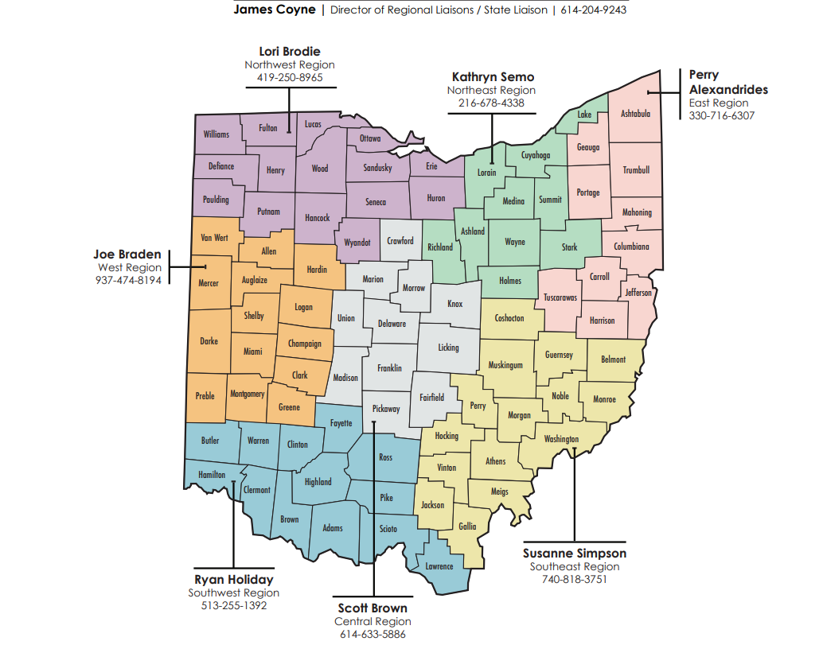
AOS Regional Liaisons

Slide 24


Questions?
For more information, please contact us:
Dorinda Byers
  dabyers@ohioauditor.gov
https://ohioauditor.gov/performance.html

