Slide 1
OhioMHAS Update
Ohio Council of County Officials
Director Lori Criss
November 2, 2022

Slide 2
OVERVIEW of OhioMHAS
Mission
Provide statewide leadership of a high-quality mental health and addiction prevention, treatment and recovery system that is effective and valued by all Ohioans.
Vision
End suffering from mental illness, substance use disorders, and problem gambling for Ohioans of all ages, their families, and communities.
Values
Demonstrate our core values in our relationships with our constituents across the state, with state agencies, and within our own department.

Slide 3
Governor DeWine
“If we build on our successes and the work we have started together, we can truly bring about lasting change… the (behavioral health) system isn’t broken – it was just never fully built, and it does not exist everywhere in Ohio… YET! And so, we must build it!”​
​From the State of the State Address, March 23, 2022

Slide 4
At the Center of This Work: Ohioans.

Slide 5
Today’s Update
Local Planning
Crisis Services and 988
Multi-System Adults Program
Criminal Justice Initiatives
Stress First Aid Tool
Q&A

Slide 6
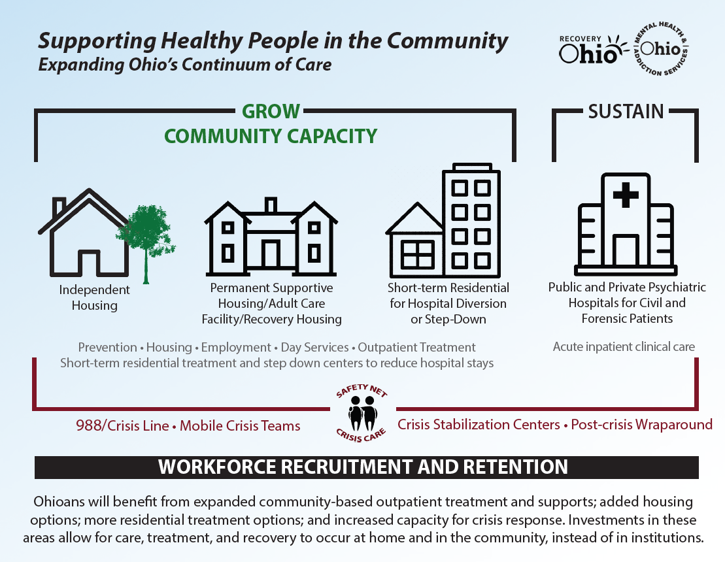
Supporting Healthy People in All of Ohio’s Communities

Slide 7
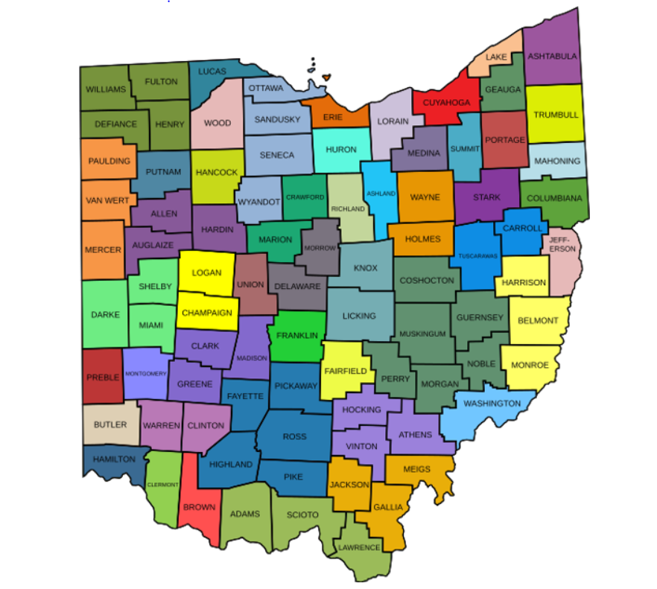
Local ADAMH Partnerships
Ohio currently has 50 Alcohol, Drug Addiction, and Mental Health (ADAMH) Boards.
Boards are statutorily empowered to plan, develop, fund, manage, and evaluate community-based mental health and addiction services.

Slide 8
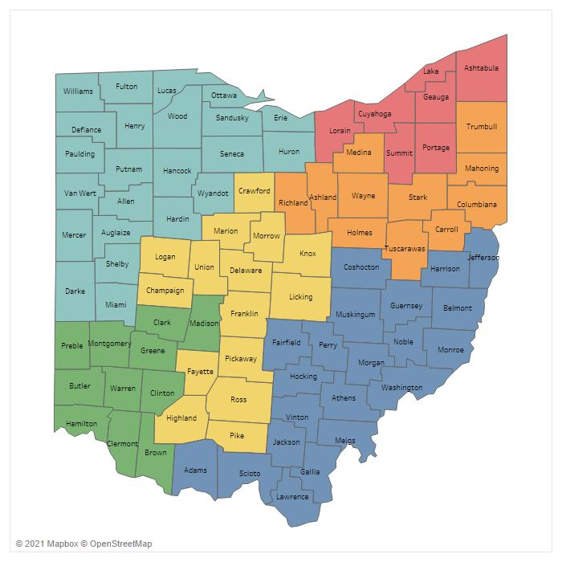
A Look at Inpatient Psychiatric Capacity for Adults in Ohio
Total Capacity: 3,999
Public Hospitals: 6
Public Beds: 1,111
Private Hospitals: 81
Private Beds: 2,720
Unlicensed Beds: 168
Notes:
Numbers updated as of August 2022.

Slide 9
Crisis Services & 988

Slide 10
Our Vision
Visible and accessible crisis continuum of services.
Supports that are person-centered and quality-driven.
Ensuring people are stabilized and thriving in their community.

Slide 11
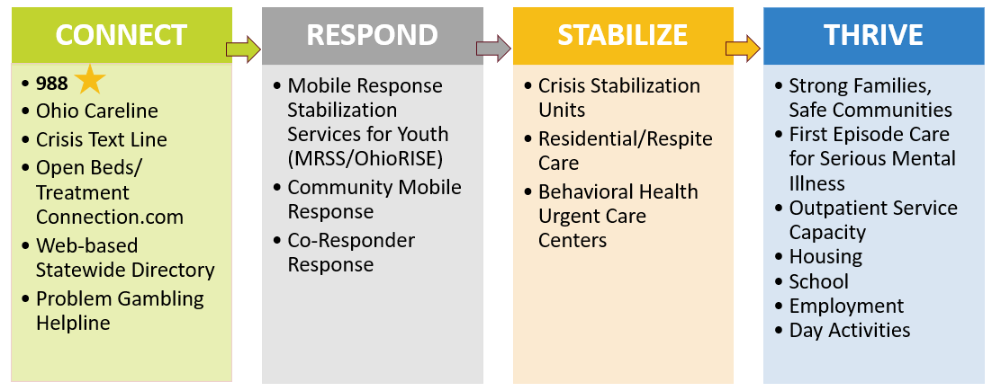
Ohio’s Crisis System: Pillars of Work

Slide 12
Key 988 Messages in Ohio
Assure Ohioans in a behavioral health crisis that help is available, and that it’s ok to ask for help.
Define what 988 is and what 988 isn’t, and how it differs from 911.
Demonstrate how Ohioans in crisis and their families can access help via 988, and what happens next when they call, chat, or text.
988 launched successfully in Ohio in July, and we are committed to the work that needs to happen in the coming months and years as this system is lifted up.

Slide 13
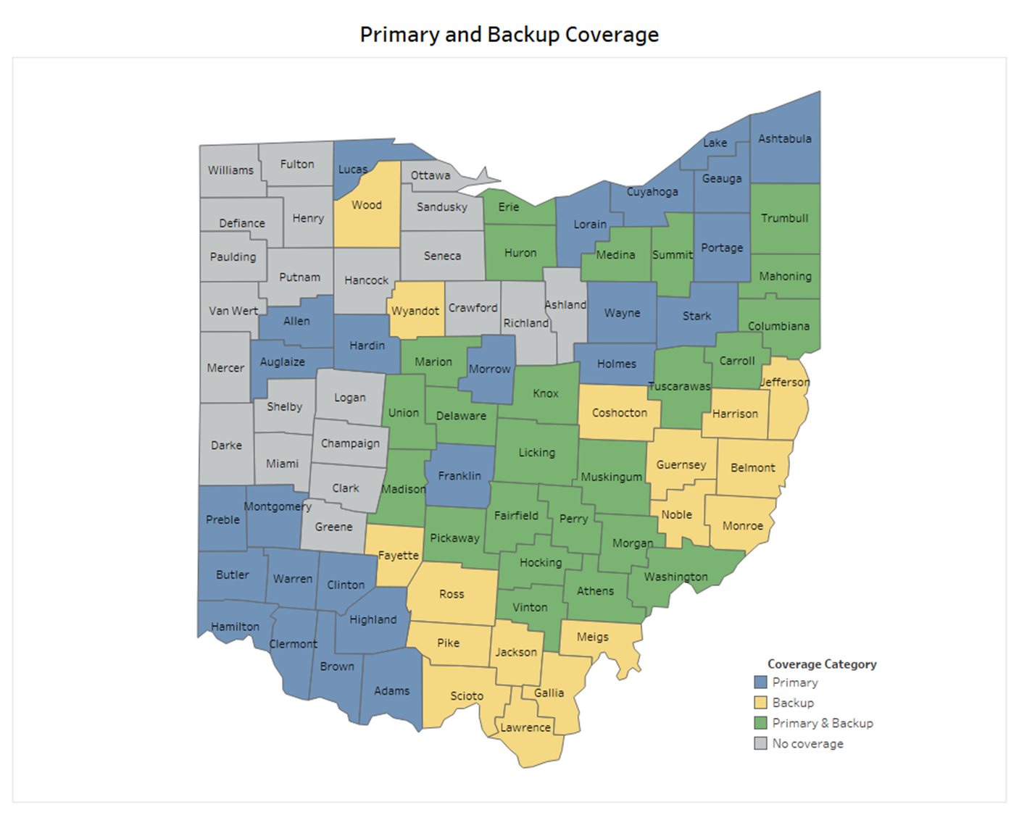
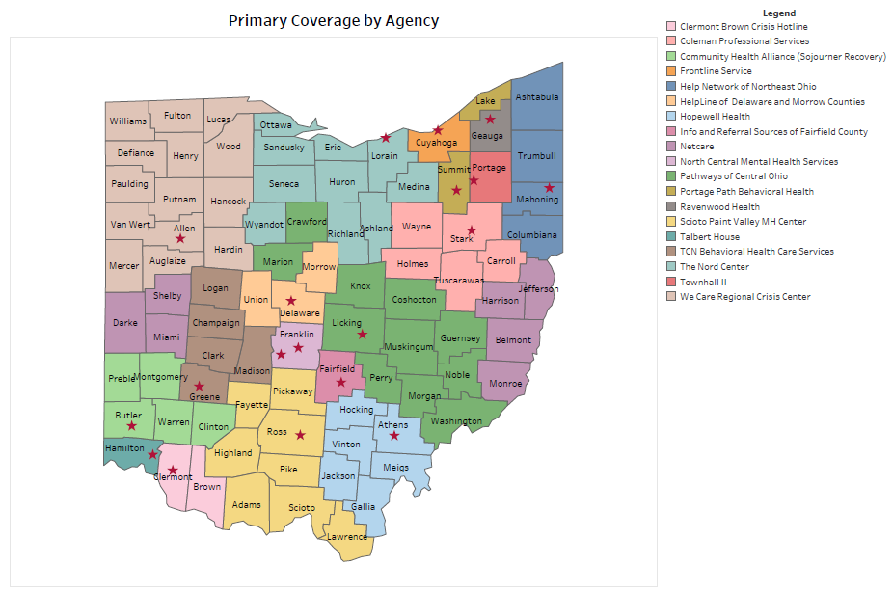
Ohio’s 988 Lifeline Center Network
Partial State Coverage Prior to May 2022
Expanded Coverage:
Ohio has grown its Lifeline Provider Network from 12 to 19 call centers, providing all 88 counties with coverage.

Slide 14
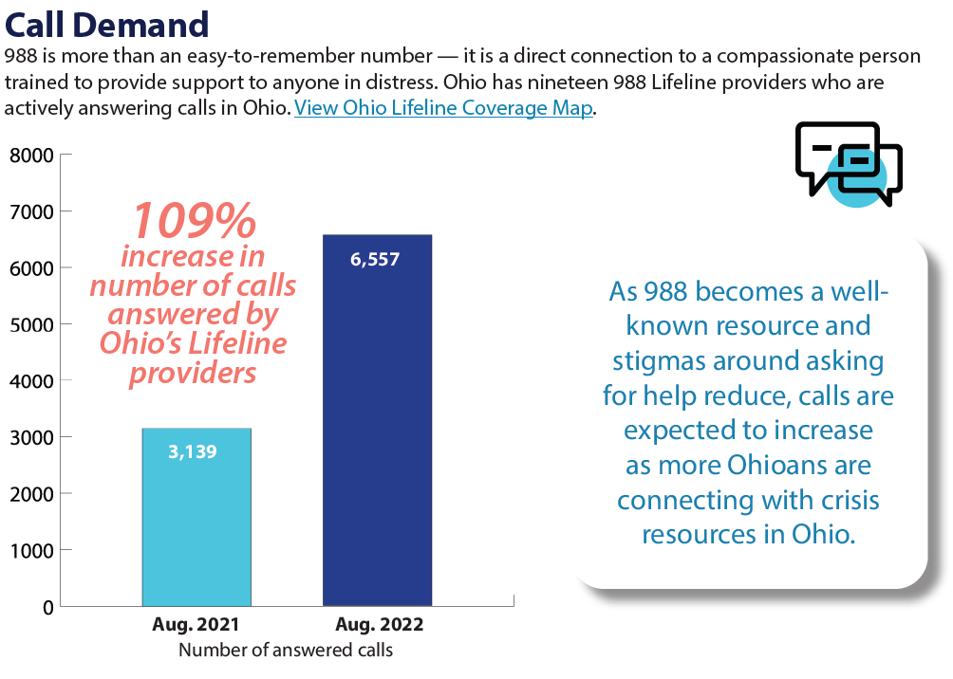
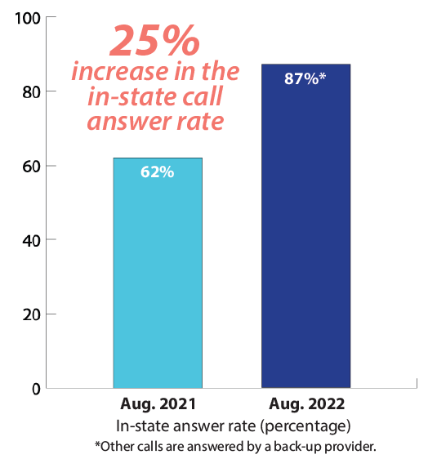
988 By the Numbers

Slide 16
Adult Access to Wellness Work

Slide 17
Multi-System Adults Enhancing Wellness Project
A strategic approach, individualized by community, to strengthen local systems collaboration to support long-term wellness for adults with serious mental illness who have frequent psychiatric hospitalizations and are involved with multiple human services and/or criminal justice systems.

Slide 18
Definition of Multi-System Adults (MSA)
An adult with significant mental illness who also has:
Two or more psychiatric hospitalizations in the last 12 months (could include a stay in a Crisis Stabilization Unit), or jail incarceration, or involvement in an Outpatient Competency Restoration Program.
and
is connected to one or more other system of care.
Aging (over 65)
Criminal Justice
Developmental Disabilities
Homeless
Veterans

Slide 19
Project Stakeholders
NAMI/Individuals Served/Families
Hospitals- State and Private
Police/First Responders/Jails
Behavioral Health Providers
Peer Run Organizations
Courts/Supervising Authorities
Agencies on Aging
Veteran’s Administration
Developmental Disabilities Board
Person-centered Care Coordination
Guardianship Organizations
Homeless Serving Agencies
Housing Providers/Landlords
Day Service Providers
Re-entry Coalition
Other Relevant Entities

Slide 20
Strategy #1: Systems Collaboration
Goal: Develop and/or strengthen communication and collaboration between local systems and secure available resources with a focus on sustainability.
Draw on existing resources from OhioMHAS.
Draw on existing supports within the community.
Draw on existing statewide resources.
Draw on existing local, state, and federal resources.

Slide 21
Strategy #2: Person-Centered Use of Funds
Rent/Security Deposits, Hotel Stays, Utilities, Furniture, Damages
Bus passes, gas cards
Assessments, specialized services, case management, co-pays, activities
Short-term Childcare
Medication alerts, medications/ monitoring, specialized services
Fees to obtain ID, birth certificate/ SS cards
Materials needed for work, job training, GED, certifications, licensures
Parenting classes, life skills
Guardianship Fees
Food, Clothing, Cleaning, Hygiene, Pre-paid phone and minutes
Provider staff for MSA project
Landlord Incentives

Slide 22
FY22 Summary: Real Results for Ohioans
31 ADAMHS boards were spending MSA funds in some capacity within 90 days of receiving those funds.
44 county ADAMHS boards participated in FY22.
Boards identified provider partners, developed referral systems, conducted outreach, developed collaborative teams and/or utilized existing collaborations, identified eligible individuals, monitored use of the project, and expanded where necessary.
400 Ohioans served.

Slide 23
Criminal Justice Initiatives

Slide 24
OhioMHAS Specialized Docket Subsidy Program
Expanding Access
Over 200 dockets throughout Ohio have been awarded funds.
$17.5 million in SFY20-21 supported current courts and expanded specialty docket access to more communities.
SFY22-23 budget provides $20 million to expand specialized dockets.
Real Results for Ohioans:
Over 7,400 people served in SFY22.
ODRC recidivism rate of 3%, compared to the three-year recidivism rate of 20.8% for the overall ODRC population.
ODYS recidivism rate of 1%, compared to the three-year recidivism rate of 32.69% for the overall ODYS population.

Slide 25
MAT Reimbursement
Psychotropic Drug Reimbursement
Reimbursement to counties for the cost of psychotropic drugs that are dispensed to inmates of county jails in Ohio.
In SFY21, approximately 70 county jails received reimbursements totaling $2.5 million.
$3M GRF each Fiscal Year
$2M GRF each Fiscal Year
Reimbursement to counties for the cost of drugs administered or dispensed to inmates of county jails in medication assisted treatment or in withdrawal management or detoxification.
Eligible drugs include not only those used for opioid treatment, but also alcohol treatment.
A list of eligible medications can be found on mha.ohio.gov.

Slide 26
BH-CJ Linkage Programs
Community Transition Program
Offers adults returning home from prison a transitional benefit of treatment and recovery support services like housing, transportation, work, and education. The current budget invests $10M in this work.
Encourages communities in Ohio to forge collaborative relationship between the behavioral health and criminal justice systems in order to reduce recidivism, increase public safety and minimize harm.
Real Results for Ohioans:
In the last fiscal year, over 15,000 Ohioans across 57 counties were served through the Behavioral Health-Criminal Justice linkage programs.

Slide 27
Expanding Crisis Intervention Training (CIT)
Statewide Goals
Increase number of new Law Enforcement agencies participating in CIT courses.
Increase advanced, refresher, and companion courses.
Development of new coordinators and trainers.
Increase CIT data gathering and sharing.
Increase Law Enforcement policies and procedures related to mental health encounters.

Slide 28
Stress First Aid

Slide 29
What is Stress First Aid?
Helps foster longevity in the job.
Reduces stigma by changing culture.
A framework to improve recovery from stress reactions.
Addresses stress reactions before they create problems.
Creates a common language to address stress.
www.mha.ohio.gov/StressFirstAid
Source: U.S. Department of Veterans Affairs, https://www.ptsd.va.gov/professional/treat/type/stress_first_aid.asp

Slide 30
Essential Stress First Aid Skills
Recognize
Recognize when a friend, family member, or coworker has a stress injury.
Act
Act: If you see something, do or say something:
To the distressed person.
To a trusted support of the distressed person.
Know
Know at least two trusted resources you would access or offer to a friend, family member, or coworker in distress.

Slide 31
Stress Continuum Model: Where Are You?
READY (Green) | REACTING (Yellow) | INJURED (Orange) | ILL (Red)
DEFINITION Optimal functioning Adaptive growth Wellness FEATURES At one’s best Well-trained and prepared In control Physically, mentally and spiritually fit Mission-focused Motivated Calm and steady Having fun Behaving ethically | DEFINITION Mild and transient distress or impairment Always goes away Low risk CAUSES Any stressor FEATURES Feeling irritable, anxious or down Loss of motivation Loss of focus Difficulty sleeping Muscle tension or other physical changes Not having fun | DEFINITION More severe and persistent distress or impairment Leaves a scar Higher risk CAUSES Life threat Loss Moral injury Wear and tear FEATURES Loss of control Panic, rage or depression No longer feeling like normal self Excessive guilt, shame or blame Misconduct | DEFINITION Clinical mental disorder Unhealed stress injury causing life impairment TYPES PTSD Depression Anxiety Substance abuse FEATURES Symptoms persist and worsen over time Severe distress or social or occupational impairment
Notes:
31

Slide 32
Stress First Aid Model

Slide 33
Need additional guidance or help? It’s OK to ask. Contact the Ohio CareLine at 1-800-720-9616 for free emotional support or if in crisis, call, text, or chat 988.
Ohio CareLine

Slide 34
Questions | Discussion

Slide 35
Resources
OhioMHAS www.mha.ohio.gov (Strategic Plan: www.mha.ohio.gov/about-us/mission-vision-and-values)
RecoveryOhio www.recoveryohio.gov
Ohio’s ADAMH Boards www.oacbha.org
988 www.988lifeline.org

Slide 36
Connect with Us

